Slide 1
Delta Debugging
Politecnico di Milano
An advanced debugging technique
Authors:
Carlo Curino, Alessandro Giusti
AAIS 05
Curino, Giusti

Slide 2
Delta Debugging
An advanced debugging technique
Simplifying and Isolating
Failure-Inducing Input
AAIS 05
Curino, Giusti

Slide 3
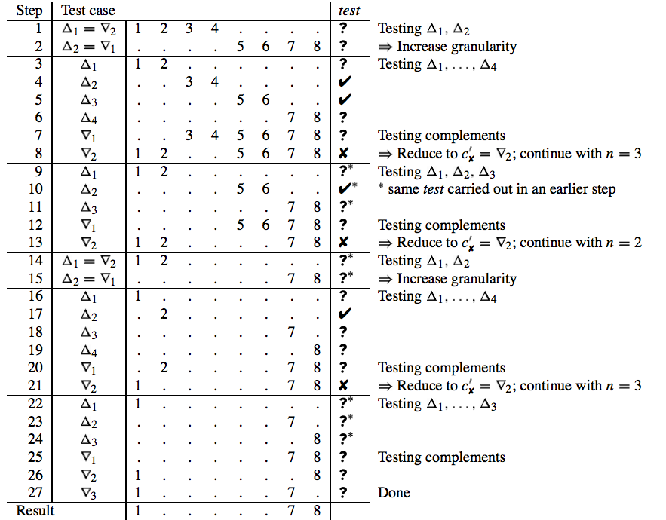
Minimizing: didactic example
AAIS 05
Curino, Giusti

Slide 4
Example
Consider the following minimal test case which consists of the changes δ₁, δ₇, and δ₈
  Any test case that includes only a subset of these changes results in an unresolved test outcome
  A test case that includes none of these changes passes the test
We first partition the set of changes in two halves
  none of them passes the test
1 | Δ₁ = ∇₂ | δ₁ | δ₂ | δ₃ | δ₄ | ⋅ | ⋅ | ⋅ | ⋅ | ?
2 | Δ₂ = ∇₁ | ⋅ | ⋅ | ⋅ | ⋅ | δ₅ | δ₆ | δ₇ | δ₈ | ?

Slide 5
Example
We continue with granularity increased to four subsets
When testing the complements, the set ∇₂ fails, thus removing changes δ₃ and δ₄
We continue with splitting ∇₂ into three subsets
3 | Δ₁ | δ₁ | δ₂ | ⋅ | ⋅ | ⋅ | ⋅ | ⋅ | ⋅ | ?
4 | Δ₂ | ⋅ | ⋅ | δ₃ | δ₄ | ⋅ | ⋅ | ⋅ | ⋅ | ✓
5 | Δ₃ | ⋅ | ⋅ | ⋅ | ⋅ | δ₅ | δ₆ | ⋅ | ⋅ | ✓
6 | Δ₄ | ⋅ | ⋅ | ⋅ | ⋅ | ⋅ | ⋅ | δ₇ | δ₈ | ?
7 | ∇₁ | ⋅ | ⋅ | δ₃ | δ₄ | δ₅ | δ₆ | δ₇ | δ₈ | ?
8 | ∇₂ | δ₁ | δ₂ | ⋅ | ⋅ | δ₅ | δ₆ | δ₇ | δ₈ | ✗

Slide 6
Example
Steps 9 to 11 have already been carried out and need not be repeated (marked with *)
When testing ∇₂, changed δ₅ and δ₆ can be eliminated
We reduce to ∇₂ and continue with two subsets
9 | Δ₁ | δ₁ | δ₂ | ⋅ | ⋅ | ⋅ | ⋅ | ⋅ | ⋅ | ?*
10 | Δ₂ | ⋅ | ⋅ | ⋅ | ⋅ | δ₅ | δ₆ | ⋅ | ⋅ | ✓*
11 | Δ₃ | ⋅ | ⋅ | ⋅ | ⋅ | ⋅ | ⋅ | δ₇ | δ₈ | ✓*
12 | ∇₁ | ⋅ | ⋅ | ⋅ | ⋅ | δ₅ | δ₆ | δ₇ | δ₈ | ?
13 | ∇₂ | δ₁ | δ₂ | ⋅ | ⋅ | ⋅ | ⋅ | δ₇ | δ₈ | ✗

Slide 7
Example
14 | Δ₁ = ∇₂ | δ₁ | δ₂ | ⋅ | ⋅ | ⋅ | ⋅ | ⋅ | ⋅ | ?*
15 | Δ₂ = ∇₁ | ⋅ | ⋅ | ⋅ | ⋅ | ⋅ | ⋅ | δ₇ | δ₈ | ?*
We increase granularity to four subsets and test each
Testing the complements shows the we can eliminate δ₂
16 | Δ₁ | δ₁ | ⋅ | ⋅ | ⋅ | ⋅ | ⋅ | ⋅ | ⋅ | ?
17 | Δ₂ | ⋅ | δ₂ | ⋅ | ⋅ | ⋅ | ⋅ | ⋅ | ⋅ | ✓
18 | Δ₃ | ⋅ | ⋅ | ⋅ | ⋅ | ⋅ | ⋅ | δ₇ | ⋅ | ?
19 | Δ₄ | ⋅ | ⋅ | ⋅ | ⋅ | ⋅ | ⋅ | ⋅ | δ₈ | ?
20 | ∇₁ | ⋅ | δ₂ | ⋅ | ⋅ | ⋅ | ⋅ | δ₇ | δ₈ | ?
21 | ∇₂ | δ₁ | ⋅ | ⋅ | ⋅ | ⋅ | ⋅ | δ₇ | δ₈ | ✗

Slide 8
Example
The next steps show that none of the remaining changes δ₁, δ₇, and δ₈ can be eliminated
To minimize this test case, a total of 19 different tests was required
22 | Δ₁ | δ₁ | ⋅ | ⋅ | ⋅ | ⋅ | ⋅ | ⋅ | ⋅ | ?*
23 | Δ₂ | ⋅ | ⋅ | ⋅ | ⋅ | ⋅ | ⋅ | δ₇ | ⋅ | ?*
24 | Δ₃ | ⋅ | ⋅ | ⋅ | ⋅ | ⋅ | ⋅ | ⋅ | δ₈ | ?*
25 | ∇₁ | ⋅ | ⋅ | ⋅ | ⋅ | ⋅ | ⋅ | δ₇ | δ₈ | ?
26 | ∇₂ | δ₁ | ⋅ | ⋅ | ⋅ | ⋅ | ⋅ | ⋅ | δ₈ | ?
27 | ∇₃ | δ₁ | ⋅ | ⋅ | ⋅ | ⋅ | ⋅ | δ₇ | ⋅ | ?

Slide 9
General DD Algorithm
Initial Fail
Differences
Initial Pass
AAIS 05
Curino, Giusti

Slide 10
General DD Algorithm
Initial Fail
What if we remove these diff
from current failing test?
Differences
Initial Pass
AAIS 05
Curino, Giusti

Slide 11
General DD Algorithm
Initial Fail
Differences
Failure disappears:
“Move up”
Initial Pass
AAIS 05
Curino, Giusti

Slide 12
General DD Algorithm
Initial Fail
What if we remove these diff?
Differences
Initial Pass
AAIS 05
Curino, Giusti

Slide 13
General DD Algorithm
Initial Fail
UNRESOLVED TEST:
“Increase Granularity”
Differences
Initial Pass
AAIS 05
Curino, Giusti

Slide 14
General DD Algorithm
Initial Fail
What if we remove these diff
from current failing test?
Differences
Initial Pass
AAIS 05
Curino, Giusti

Slide 15
General DD Algorithm
Initial Fail
Still Fails:
“Move Down”
Differences
Initial Pass
AAIS 05
Curino, Giusti

Slide 16
Find Failure-Inducing Input
double mult(double z[], int n)
{ int i , j ;
i = 0;
for ( j = 0; j < n; j++) {
i = i + j + 1;
z[i ] = z[i ]*(z[0] + 1.0);
}
return z[n];
}
Figure 1: The fail.c program that crashes GCC
$ gcc -O fail.c
gcc: Internal compiler error: program cc1 got fatal signal 11
$ _

Slide 17
GCC Example
double mult(double z[], int n)
{ int i , j ;
i = 0;
for ( j = 0; j < n; j++) {
i = i + j + 1;
z[i ] = z[i ]*(z[0] + 1.0 );
}
return z[n];
}
Figure 1: The fail.c program that crashes GCC
$ gcc -O fail.c
gcc: Internal compiler error: program cc1 got fatal signal 11
$ _
+ 1.0 is the failure cause

Slide 18
Search
# GCC Input Test
1 double mult(. . . ) { int i , j ; i = 0; for (. . . ) { . . . } . . . }
2 /* empty file */
3 double mult(. . . ) { }
4 double mult(. . . ) { int i , j ; i = 0;}
5 double mult(. . . ) { int i , j ; i = 0; for (. . . ) { . . . } }
6 double mult(. . . ) { int i , j ; i = 0; for (. . . ) { } }
. . . . . . . . . . .
18 . . . z[i ] = z[i ]*(z[0] + 1.0); . . .
19 . . . z[i ] = z[i ]*(z[0] ); . . .
20 . . . z[i ] = z[i ]*(z[0] 1.0);. . . ?
21 . . . z[i ] = z[i ]*(z[0] + ); . . . ?
Table 1: Isolating Failure-Inducing Input

Slide 19
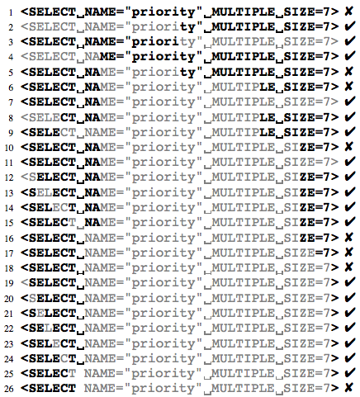
Minimizing: Mozilla bug
Minimizing:
  57 test to simplify the 896 line HTML input to the “<SELECT>” tag that causes the crash
  Each character is relevant (as shown from line 20 to 26)
  Only removes deltas from the failing test
  Returns a minimal input that causes a failure
AAIS 05
Curino, Giusti

Slide 20
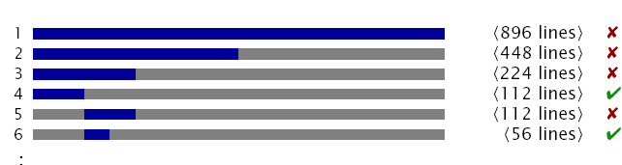
Simplified Input
Required 57 tests only
896 lines → 1line
<SELECT>

Slide 21
Simplification of test cases
The minimizing delta debugging algorithm ddmin
  Takes a failing test case
  Simplifies it by successive testing
  Stops when a minimal test case is reached
    where removing any single input entity will cause the failure to disappear

Slide 22
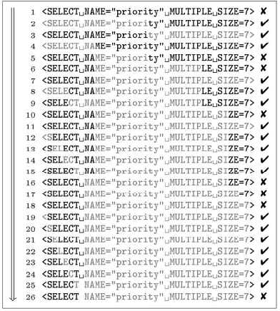
How to minimize a test case?
Test subsets with removed characters (shown in grey)
A given test case
  Fails (✗) if Mozilla crashes on it
  Passes (✓) otherwise

Slide 23
How to minimize a test case?
Original failing input
1 | <SELECTNAME="priority"MULTIPLESIZE=7> | ✗
2 | <SELECTNAME="priority"MULTIPLESIZE=7> | ✓
3 | <SELECTNAME="priority"MULTIPLESIZE=7> | ✓
Try removing half…
Now everything passes, we’ve lost the error inducing input!
Try removing a quarter… ok found something!

Slide 24
How to minimize a test case?
1 | <SELECTNAME="priority"MULTIPLESIZE=7> | ✗
2 | <SELECTNAME="priority"MULTIPLESIZE=7> | ✓
3 | <SELECTNAME="priority"MULTIPLESIZE=7> | ✓
Try removing a quarter instead
4 | <SELECTNAME="priority"MULTIPLESIZE=7> | ✓
5 | <SELECTNAME="priority"MULTIPLESIZE=7> | ✗
OK, we’ve got
something!
So keep it, and continue…
Good, carry on
6 | <SELECTNAME="priority"MULTIPLESIZE=7> | ✗
Lost it!
Try removing an eighth instead…
7 | <SELECTNAME="priority"MULTIPLESIZE=7> | ✓

Slide 25
How to minimize a test case?
6 | <SELECTNAME="priority"MULTIPLESIZE=7> | ✗
7 | <SELECTNAME="priority"MULTIPLESIZE=7> | ✓
Removing an eighth
Good, keep it!
8 | <SELECTNAME="priority"MULTIPLESIZE=7> | ✓
9 | <SELECTNAME="priority"MULTIPLESIZE=7> | ✓
10 | <SELECTNAME="priority"MULTIPLESIZE=7> | ✗
11 | <SELECTNAME="priority"MULTIPLESIZE=7> | ✓
Lost it!
Try removing a sixteenth instead…
12 | <SELECTNAME="priority"MULTIPLESIZE=7> | ✓
13 | <SELECTNAME="priority"MULTIPLESIZE=7> | ✓
14 | <SELECTNAME="priority"MULTIPLESIZE=7> | ✓
15 | <SELECTNAME="priority"MULTIPLESIZE=7> | ✓
16 | <SELECTNAME="priority"MULTIPLESIZE=7> | ✗
17 | <SELECTNAME="priority"MULTIPLESIZE=7> | ✗
18 | <SELECTNAME="priority"MULTIPLESIZE=7> | ✗
Great! we’re making progress
OK, now let’s see if removing single characters helps us reduce it even more

Slide 26
How to minimize a test case?
17 | <SELECTNAME="priority"MULTIPLESIZE=7> | ✗
18 | <SELECTNAME="priority"MULTIPLESIZE=7> | ✗
Removing a single character
19 | <SELECTNAME="priority"MULTIPLESIZE=7> | ✓
20 | <SELECTNAME="priority"MULTIPLESIZE=7> | ✓
21 | <SELECTNAME="priority"MULTIPLESIZE=7> | ✓
22 | <SELECTNAME="priority"MULTIPLESIZE=7> | ✓
23 | <SELECTNAME="priority"MULTIPLESIZE=7> | ✓
24 | <SELECTNAME="priority"MULTIPLESIZE=7> | ✓
25 | <SELECTNAME="priority"MULTIPLESIZE=7> | ✓
26 | <SELECTNAME="priority"MULTIPLESIZE=7> | ✗
Reached a minimal test case!
Therefore, this should be our
test case
26 | <SELECTNAME="priority"MULTIPLESIZE=7> | ✗

Slide 27
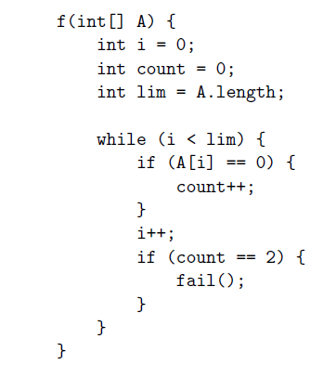
A consists of all 0’s (2) All 1’s except first and last
element which is 0
Solved in Class
Answer discussed in
Class
AAIS 05
Curino, Giusti

